Slide 1
Object- Oriented Design
Movie System
Group 3
Che Li, Chang Li, Yuting Wang, Yakun Zhang

Slide 2
Requirements and Analysis Model

Slide 3
Use Case Diagram

Slide 4
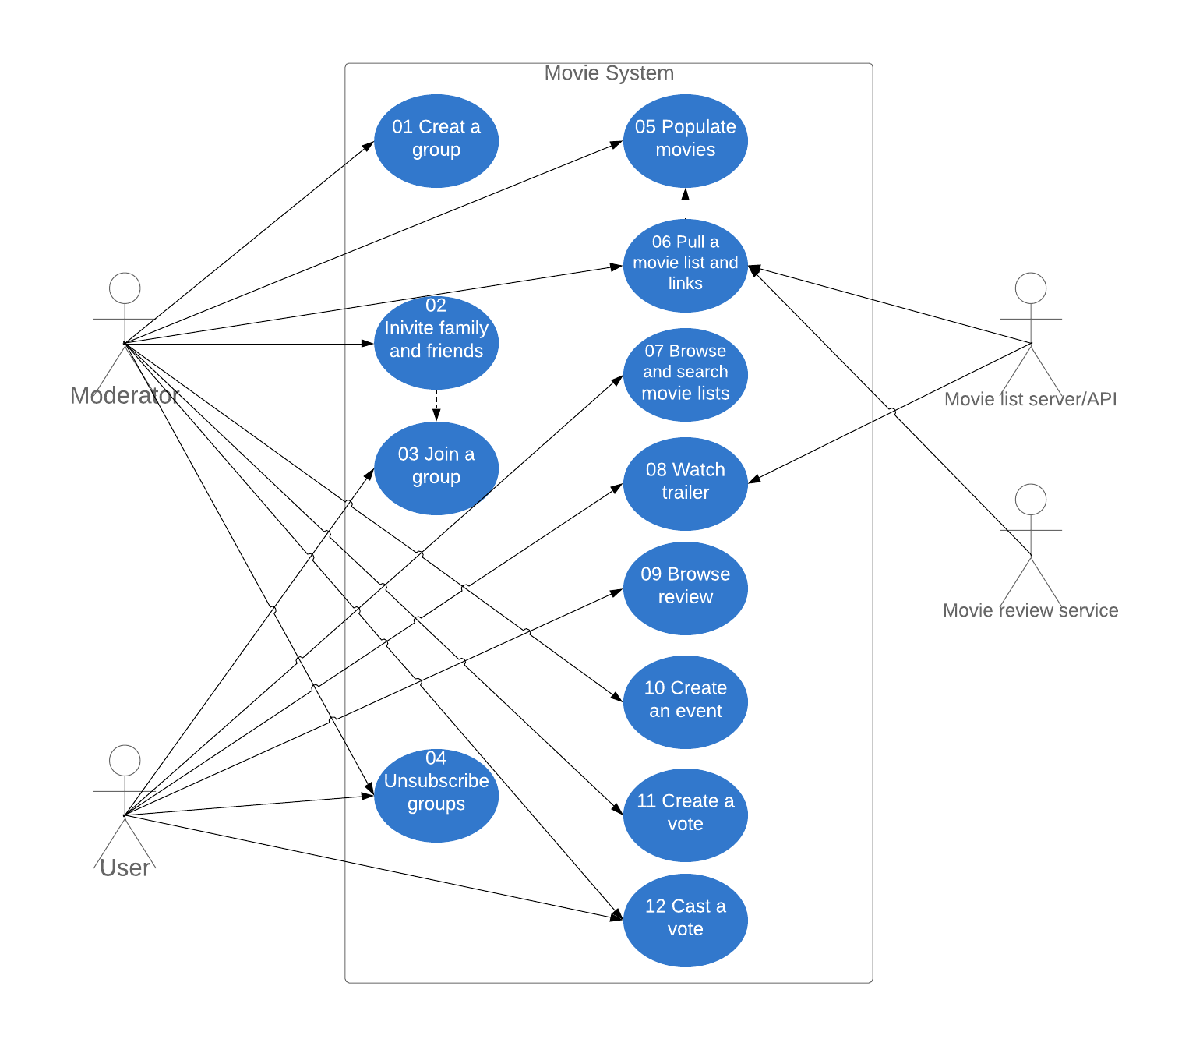
Diagram

Slide 5
Use Case Specification

Slide 6
01 Create a group
Use Case: Create a group
ID: SUPER-USR01
Actors: group moderator
Preconditions: Have an account; Successfully login
Postconditions: User become a group moderator

Slide 7
01 Create a group
Step:
User clicks ‘ create group’ button
The system receives the request
The system displays the group register page
User fills the required information in the page
User clicks ‘create’ button
The system receives the information
The system checks duplicate, if no then next step, otherwise displays an error and back to step 3
The system displays a new group main page

Slide 8
01 Create a group
Description:
This use case starts when a group moderator creates a group; the system responds with the establishment of the group. Moderator identifies themself to the system by entering a unique user ID. System acknowledge moderator by user name and request password. Moderator gives instructions (ID: 01) about creating a group to the system, the system accepts the instructions and implement the instructions, and asks for group information. Moderator names the group and enters a description of the group. The system confirms the correctness of the information. This use case ends with the moderator satisfied with the information and confirms that the group has been created.

Slide 9
02 Invite family and friends
Use Case: Invite family and friends
ID: SUPER-USR02
Actors: group moderator
Preconditions: User successfully becomes a moderator
Postconditions: User successfully invited group members

Slide 10
02 Invite family and friends
Step:
Group moderator clicks ‘ invite a group member’ button
The system receives the request
The system displays the group member invitation page
Group moderator fills the required information in the page
Group moderator clicks ‘invite’ button
The system receives the information
The system checks the information, if correct then next step, otherwise displays an error and back to step 3
The system displays a new successfully invited a user page

Slide 11
02 Invite family and friends
Description:
This use case starts when a group moderator invites a family or friend user to join in the group; the system responds with accept(or not accept) the family or friend user to a group member. Moderator enters the user name who is been invited. The system acknowledges correctness the user name(Exception: No user name), and send an invitation to inform the user. This use case ends with the user accept(or not accept) the invitation and join in the group.

Slide 12
03 Join a group
Use Case: Join a group
ID: USR03
Actors: group members
Preconditions: Have an account; Successfully login
Postconditions: User successfully become a group member

Slide 13
03 Join a group
Step:
User clicks ‘ join a group’ button
The system receives the request
The system displays the group application page
User fills the required information in the page
User clicks ‘join in’ button
The system receives the information
The system checks group information, if correct then next step, otherwise displays an error and back to step 3
The system displays a new group main page

Slide 14
03 Join a group
Description:
This use case starts when a family or friend user sends a request for joining a group to the system; the system responds with accept(or not) this request. Family and friends users enter the unique group name or group ID (Exception: No group). The system accepts the name (ID) and asks for the willing to join a group. Family and friends users accept (or not) to join the group. The system updates the list of group members. This use case ends when users successfully join a group.

Slide 15
04 Unsubscribe groups
Use Case: Unsubscribe groups
ID: USR04
Actors: group moderator
Preconditions: Successfully joined in a group
Postconditions: Unsubscribe a group successfully

Slide 16
04 Unsubscribe groups
Step:
User clicks ‘ unsubscribe a group’ button
The system receives the request
The system displays the group unsubscribe page
User ticks the unsubscribe box then continue to next step, otherwise ticks the subscribe box then back to the step 1
The system receives the unsubscribe request
The system displays a unsubscribe successfully page

Slide 17
04 Unsubscribe groups
Description:
This use case starts when a group member sends an unsubscribe inform to the system: the system responds with deleting the members from the group. the group member identifies self and sends unsubscribe request to the system by entering its unique name. The system acknowledges the correctness of the name. The group member confirms the unsubscribe. This use case ends with the system delete the group member from the group.

Slide 18
05 Populate movies
Use Case: Populate movies
ID: SUPER-USR05
Actors: group moderator
Preconditions:
login the account
group has been create
group moderator has authority to access movie list
Postconditions:
a list is recorded by the system
post a list

Slide 19
05 Populate movies
Step:
user clicks ‘populate movies’ button
system receives the request
system create a blank list
system request movies names
user enter names
send names to the system
system generate a list
system post movie lists

Slide 20
05 Populate movies
Description:
This use case starts when a group moderator creates a blank list in the movie system. The group moderator populates a list of potential movies that could be watched. Then the system records the movie list and posts it. This movie list will be used in pulling the movie resource links, browsing and searching by the group members and watching the trailer. This use case ends when the group moderator delete this movie lists

Slide 21
06 Pull a movie list and links
Use Case: Pull a movie list and links
ID: SUPER-USR06
Actors: group moderator
Preconditions:
login the account and group has been create
a list of potential movies has been post in movie system
system have movie server/API url
system could access the movie server/API website
Postconditions:
the movie resource and links are recorded in the system

Slide 22
06 Pull a movie list and links
Step:
user clicks ‘Pull a movie list and links’ button
system receives the request
system requests links from movie list server/API
system send name and request links
movie server/API search links
movie server/API send the movie resource link
system records links and post links

Slide 23
06 Pull a movie list and links
Description:
This use case starts when a group moderator pulls a movie list from a movie list server/API. The movie list server/API provide the resource and links of these movies. This resource and links are recorded in the system and would be posted. These links include the movie resource, trailer resource, and reviews. [Exception - No resources, links or reviews about the movie]. This use case ends when the group moderator deletes the movie list.

Slide 24
07 Browse and search movie lists
Use Case: Browse and search movie lists
ID: USR07
Actors: group members
Preconditions:
login the account and group has been create
the movie list record in system
the movie resource and links are recorded in the system
Postconditions:
the system response the lists
the system response the search results

Slide 25
07 Browse and search movie lists
Step:
Group members click on ‘browse’ button
system receives the request show the movie lists
system post the movie list
group member click on ‘search’ button
system receives the request search function
system request movie name
group member enter movie name and send to the system
system search in database
system post the results

Slide 26
07 Browse and search movie lists
Description:
This use case starts when a group member request browses the movie lists. The system will provide the list previously created by moderator. The system provides a search function so that group members could input the movie name and the system response to the search results. The group member could search the movie name with a brief introduction, and reviews. [Exception - No results, and the system will respond to No Results]. This use case ends when the group moderator deletes the movie list.

Slide 27
08 Watch trailer
Use Case: Watch trailer
ID: USR08
Actors: group members
Preconditions:
login the account and group has been create
the movie lists created
the resource links are recorded in system
Postconditions:
the system response the trailer links

Slide 28
08 Watch trailer
Step:
group members click on ‘watch trailer’ button
system receive request the movie trailer
system response the movie trailer links
group member click on the link
request jump to the trailer page
the movie server post trailer page

Slide 29
08 Watch trailer
Description:
This use case starts when a group member requests to watch the movie trailer. The system will provide a link from the movie server/API. The group member could click on the link and jump to the trailer page. [Exception - No link(trailer) for this movie].This use case ends when the group moderator deletes the movie list.

Slide 30
09 Browse review
Use Case: Browse review
ID: USR09
Actors: group members
Preconditions:
login the account and group has been create
the movie lists created
the movie review and links are recorded in the system
Postconditions:
system response the movie reviews link

Slide 31
09 Browse review
Step:
group member click on ‘browse review’ button
system receive the request movie reviews
system response movie reviews links
group member click the links
request jump to the browse reviews page
the review server post the movie reviews page

Slide 32
09 Browse review
Description:
This use case starts when a group member request to access the movie reviews of the movies that have been populated by the moderator. The movie system provides links to the movie in the movie lists. The group member clicks on the link and jumps to the movie reviews page provided by the movie review service. Exception - No link (reviews) for this movie]This use case ends when the group moderator deletes the movie list.

Slide 33
10 Create an event
Use Case: Create an event
ID: SUPER-USR10
Actors: group moderator
Preconditions:
Have an account
Successfully login
Has access to use of the movie system to create an event
Postconditions:
An event has been created
the system keep the history of movie watching events and this history information shall only be available for the moderator and group members
after the event has been created, moderator and group members have been notified by the system

Slide 34
10 Create an event
Step:
group moderator clicks ‘create an event’ button
the system receives the operation and requests an even name
group moderator enter the name of the event
group moderator send name to system
system establish an event and keep the history of this event
system send a notification to group moderator and group members
group moderator and group members receive notification

Slide 35
10 Create an event
Description:
This use case starts when a group moderator uses the movie system to create an event; the system responds with choosing movies, votes, notifications and create an event history. The moderator names an event and chooses movies for each vote in this event; after group participants cast their votes for each movie in the voting period, the system will select a single movie winner based on the votes for this event. The use case ends with the moderator gets a movie that has the most votes.

Slide 36
11 Create a vote
Use Case: Create a vote
ID: SUPER-USR11
Actors: group moderator
Preconditions:
An event has been created
Postconditions:
A vote has been created
The system keeps the history of movie watching vote and this history information shall only be available for the moderator and group members

Slide 37
11 Create a vote
Step:
group moderator clicks ‘create a vote’ button
the system receives the operation and requests a movie name, the open and close time
group moderator enter a movie name, open time and end time for the vote
group moderator send information to the system
system establish a vote, keep the history of this vote
system post the vote

Slide 38
11 Create a vote
Description:
This use case starts when the group moderator has created an event; the system responds with choosing the time for opening and closing votes and creating votes history. The moderator choose movies to be the options of the event, and group participants will vote they want to watch (or do not want) for each of the movies; after group participants cast the votes in the voting period (after the open time and before the close time), the system will select a single movie winner based on the votes (select a movie which has the most votes for wanting to watch). The use case ends in the close time of these votes.

Slide 39
12 Cast a vote
Use Case: Cast a vote
ID: USR12
Actors: group members
Preconditions:
the time is in the voting period (after the open time and before the close time)
Postconditions:
the participants voted whether they want to watch these movies.

Slide 40
12 Cast a vote
Step:
group members clicks ‘cast a vote’ button
the system receives the operation and response the vote page with the question and two choices
group members enter a choice
group members send the choice result to the system
system record the vote, keep the history of this vote and calculate the votes
system response a single movie winner

Slide 41
12 Cast a vote
Description:
This use case starts when the votes have been opened; the system responds with votes and creates a voting history. Each of the participants in the group votes individually for each movie to decide whether they want or don't want to watch it. The use case ends with the group participants voted for all movies in the event.

Slide 42
Actors

Slide 43
Actors Definition
Moderator: The initiator of the entire event is the operator of the entire system, with most of the permissions.
Group members: Participants throughout the event, with certain permissions.
Movie list server/API: provide movie lists in system
Movie review service: provide movie reviews in system

Slide 44
Actors - Moderator
Create a group
Invite people
Unsubscribe group
Populate movie lists
Pull movie list and trailers from movie list server/API
Create an event
Open and close a vote for an event
Cast vote

Slide 45
Actors – Group Members
Join group
Unsubscribe group
Search and browse movie list
Watch trailer
Browse review
Cast vote

Slide 46
Actors - Movie list server/API
Provide movie lists
Provide movie trailer

Slide 47
Actors - Movie review service
Provide movie review link

Slide 48
Constrain
The history of movie watching events, votes, and winners only be available for the participants of the movie watching group
The system shall not allow participants of a movie watching group to change their votes AFTER the system computed the winner movie based on casted votes

Slide 49
Use Case Description
Create a group : moderator could create a movie group
Invite family and friends: moderator could invite people to join in the groups
Join a group: family and friends could join in a movie group
Unsubscribe groups: people could unsubscribe a movie group
Populate movies: moderator could populate movie to the group list
Pull a movie list and add links: moderator could add the movie link URL that provided by the movie list server/API to the group
Search and browse movie lists: family and friends could search and browse movie lists in a group
Watch trailer: family and friends could watch a trailer in a group
Browse review: family and friends could browse and add review
Create an event: moderator could create a watching event and system could notified it to group members
Create a vote: moderator could create a vote and decide the open and close time for this vote
Cast a vote: people could vote for whether they want to watch a movie

Slide 50
State Diagram

Slide 51
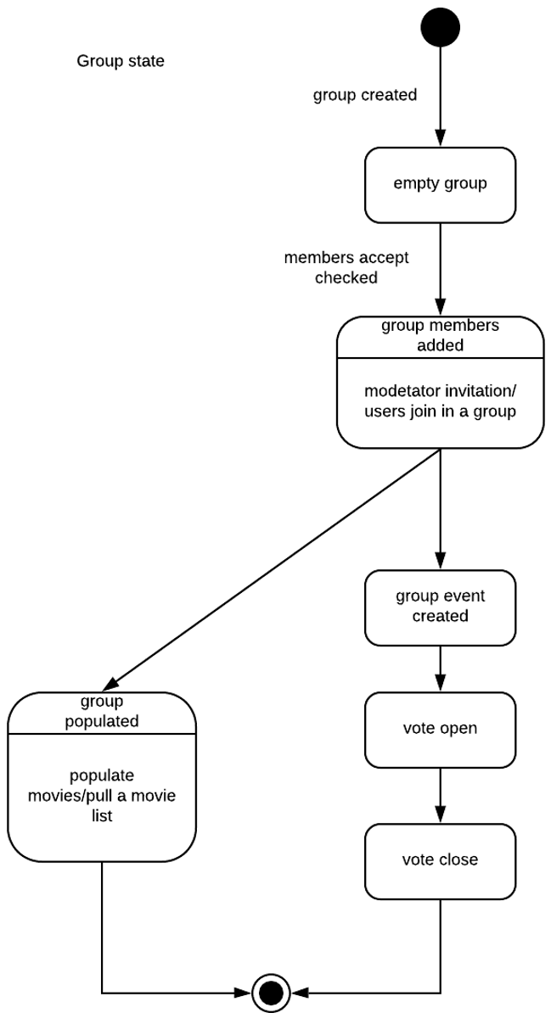
State Diagram

Slide 52
Design Model

Slide 53
Class Diagram

Slide 54
Class Description
Group: A class that encapsulates a group, including IDs of group members, for later invocation.
Group moderator: The initiator of the entire event is the operator of the entire system, with most of the permissions.
Group member: Participants throughout the event, with certain permissions.
Movie: the movie in the system that moderator can choice, members can watch, the event and vote can use.
Event: Created by moderator to decide which movie to play.
Vote: Participation by group people for sharing their opinions whether they want to watch a movie.

Slide 55
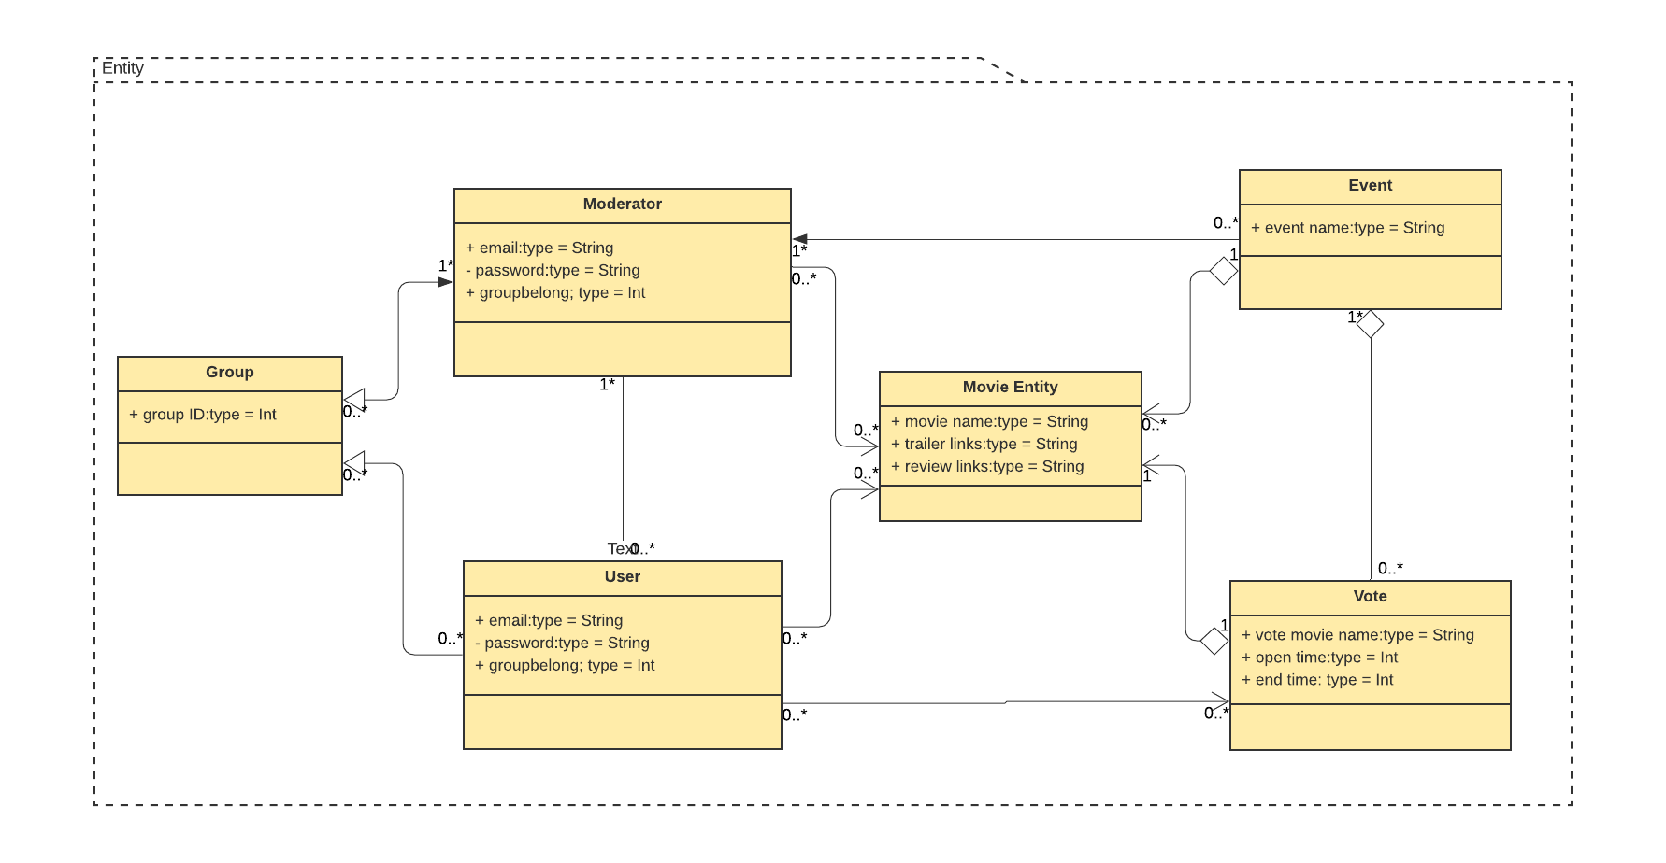
Entity Class Diagram

Slide 56
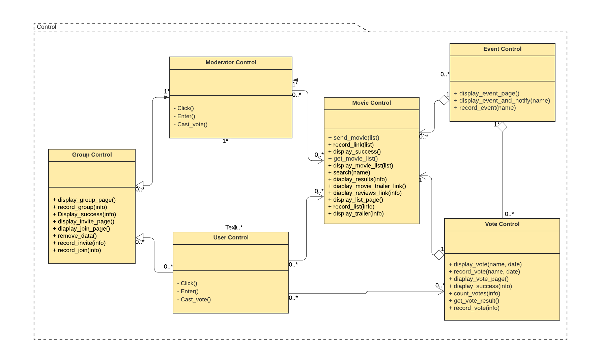
Control Class Diagram

Slide 57
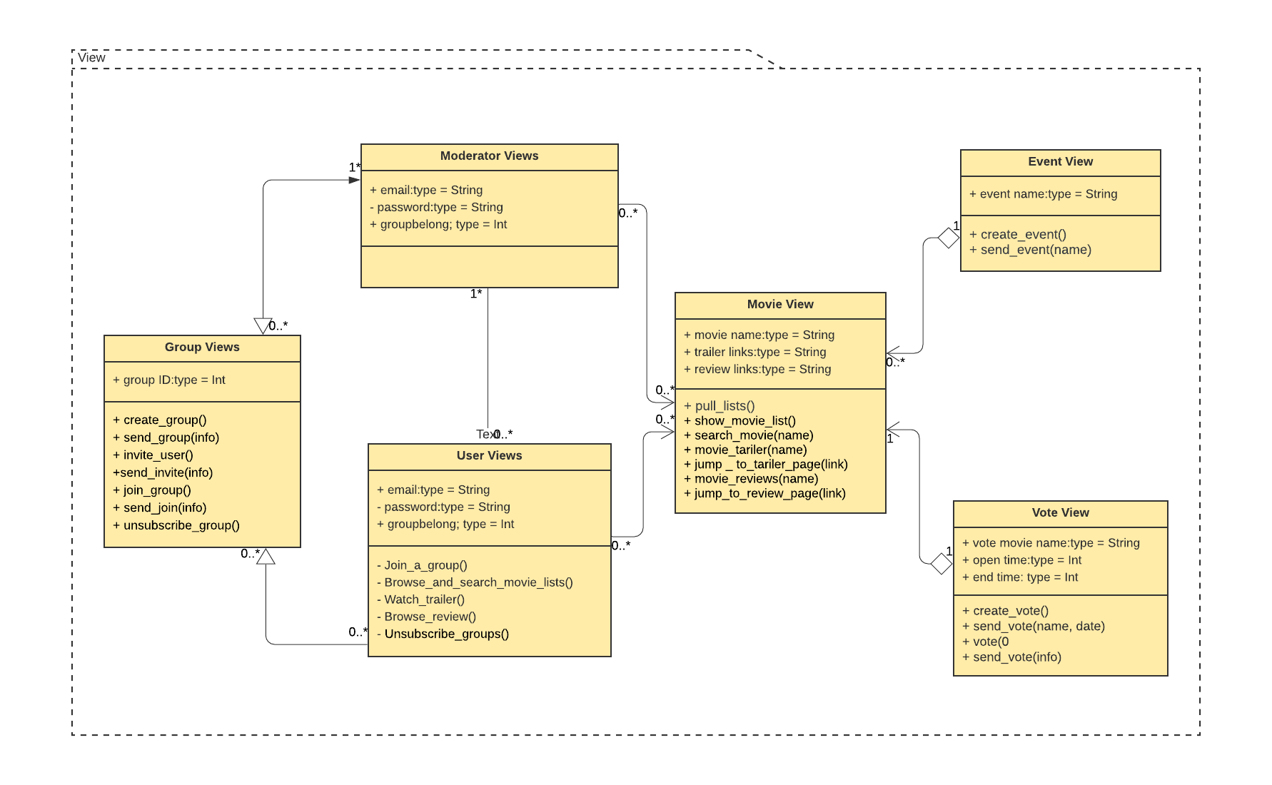
View Class Diagram

Slide 58
Sequence Diagram

Slide 59
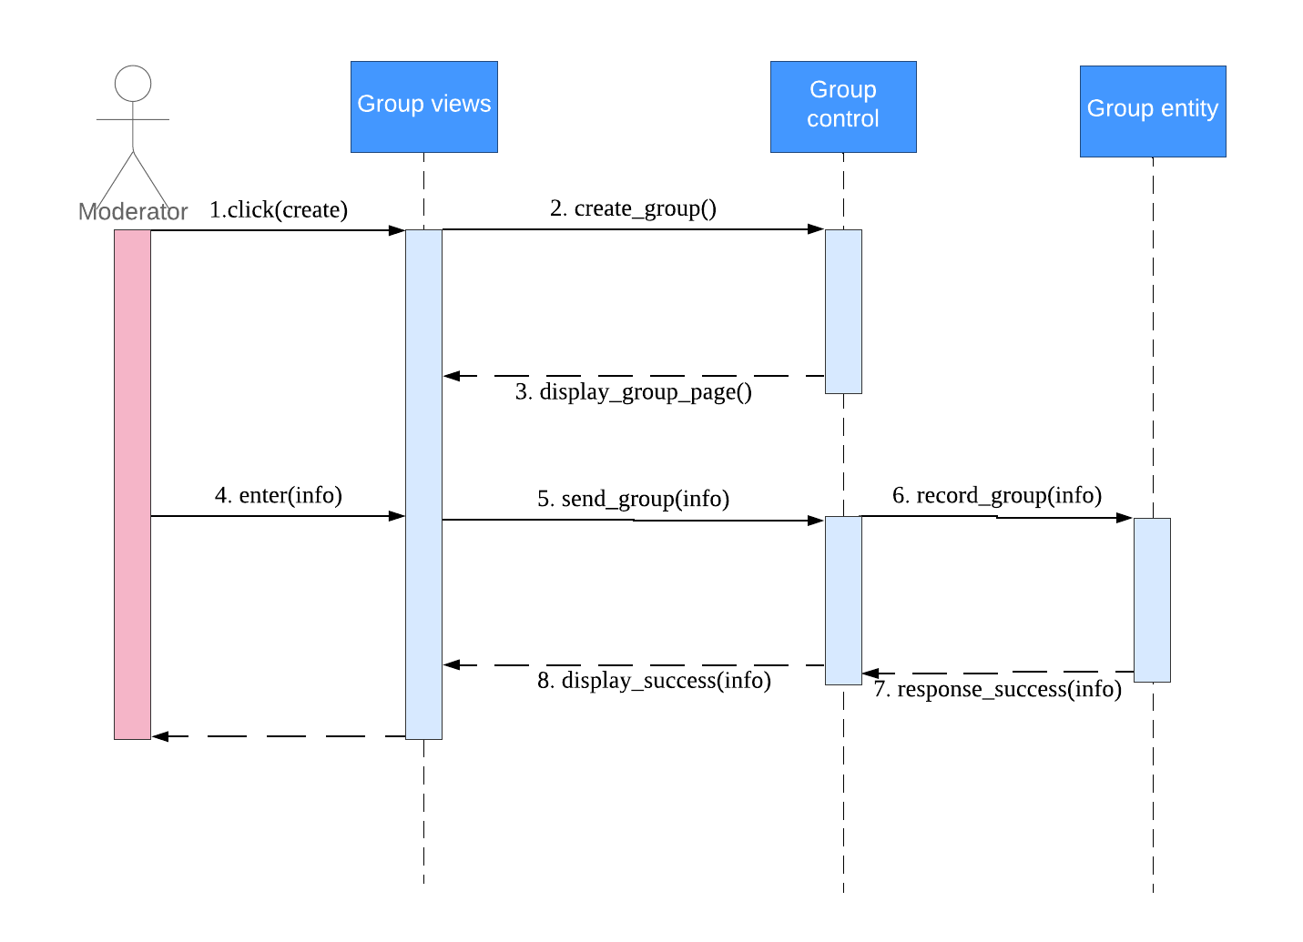
01 Create a group

Slide 60
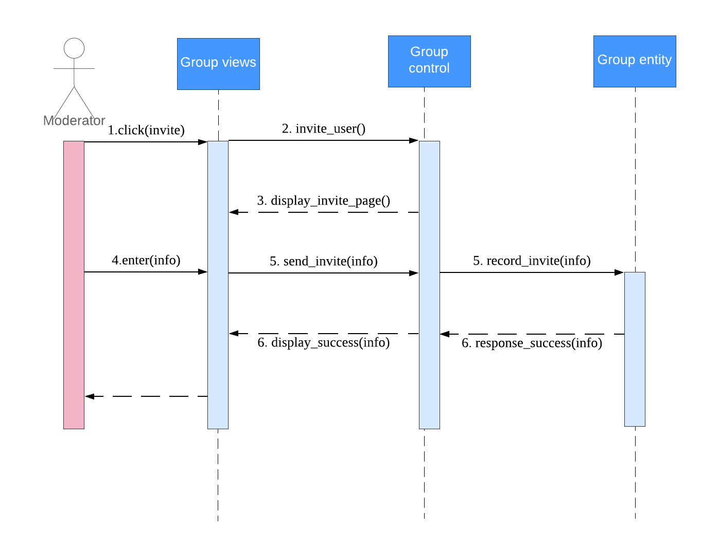
02 Invite family and friends

Slide 61
03 Join a group

Slide 62
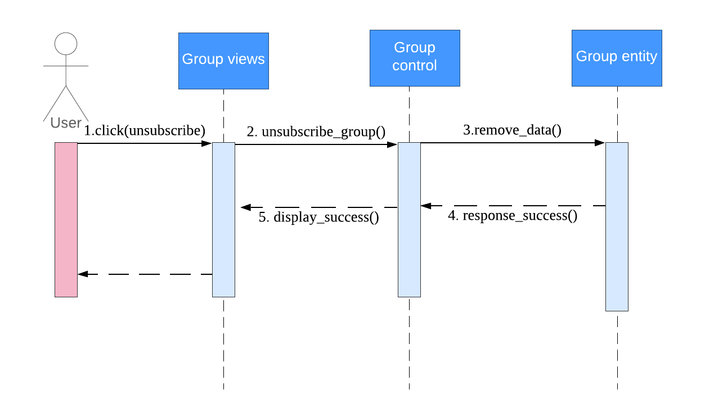
04 Unsubscribe groups

Slide 63
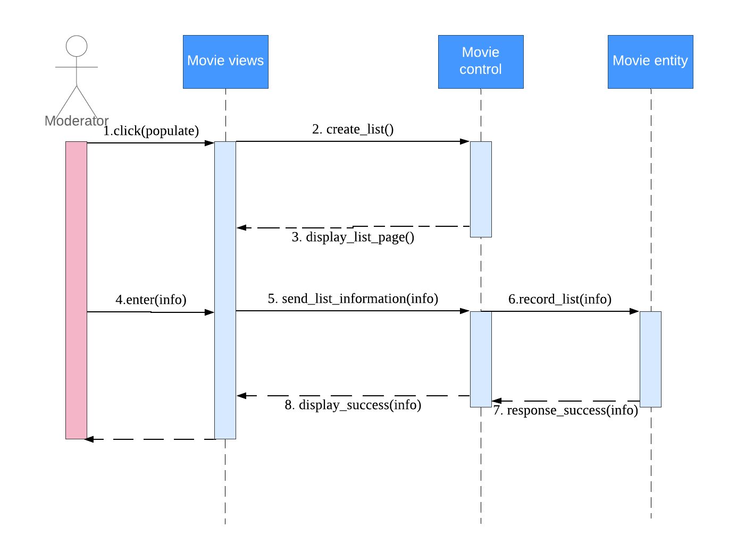
05 Populate movies

Slide 64
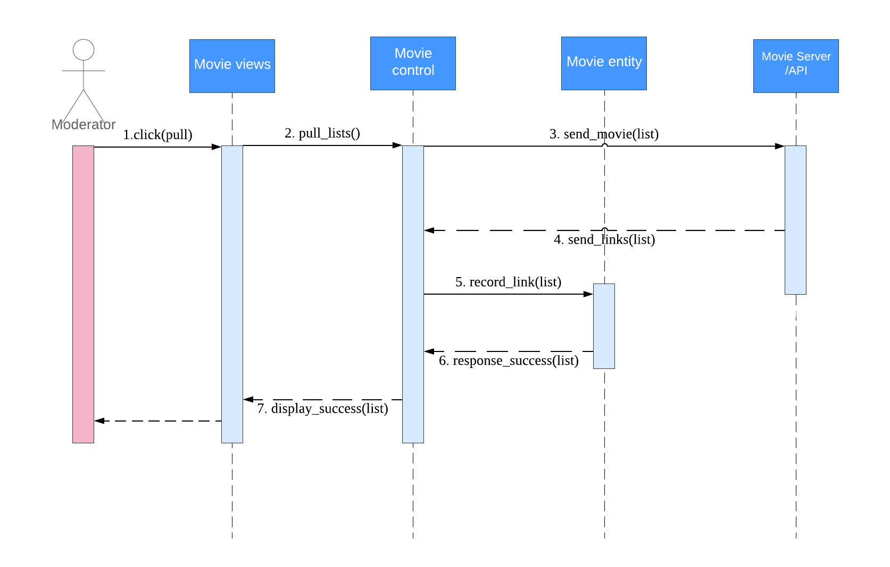
06 Pull a movie list and links

Slide 65
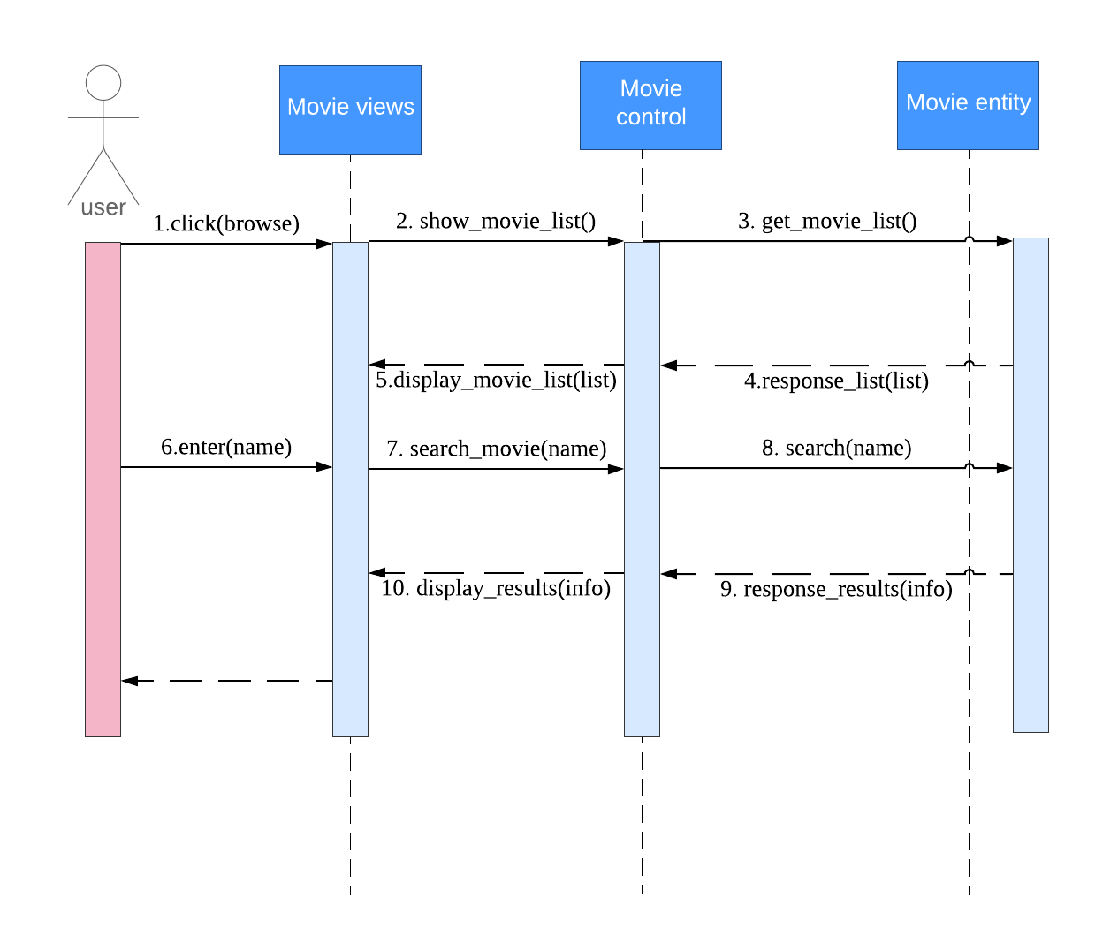
07 Browse and search movie lists

Slide 66
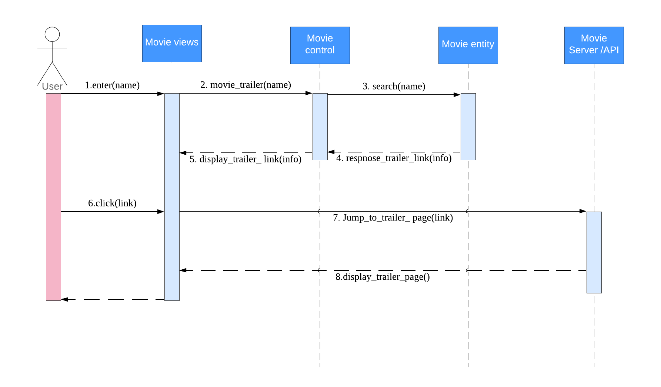
08 Watch trailer
Notes:
User

Slide 67
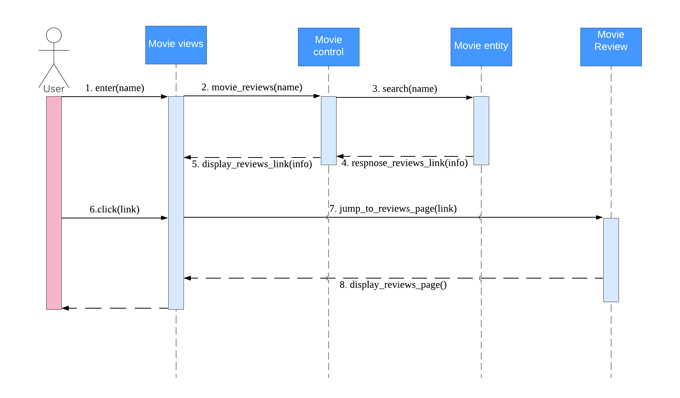
09 Browse review
Notes:
User

Slide 68
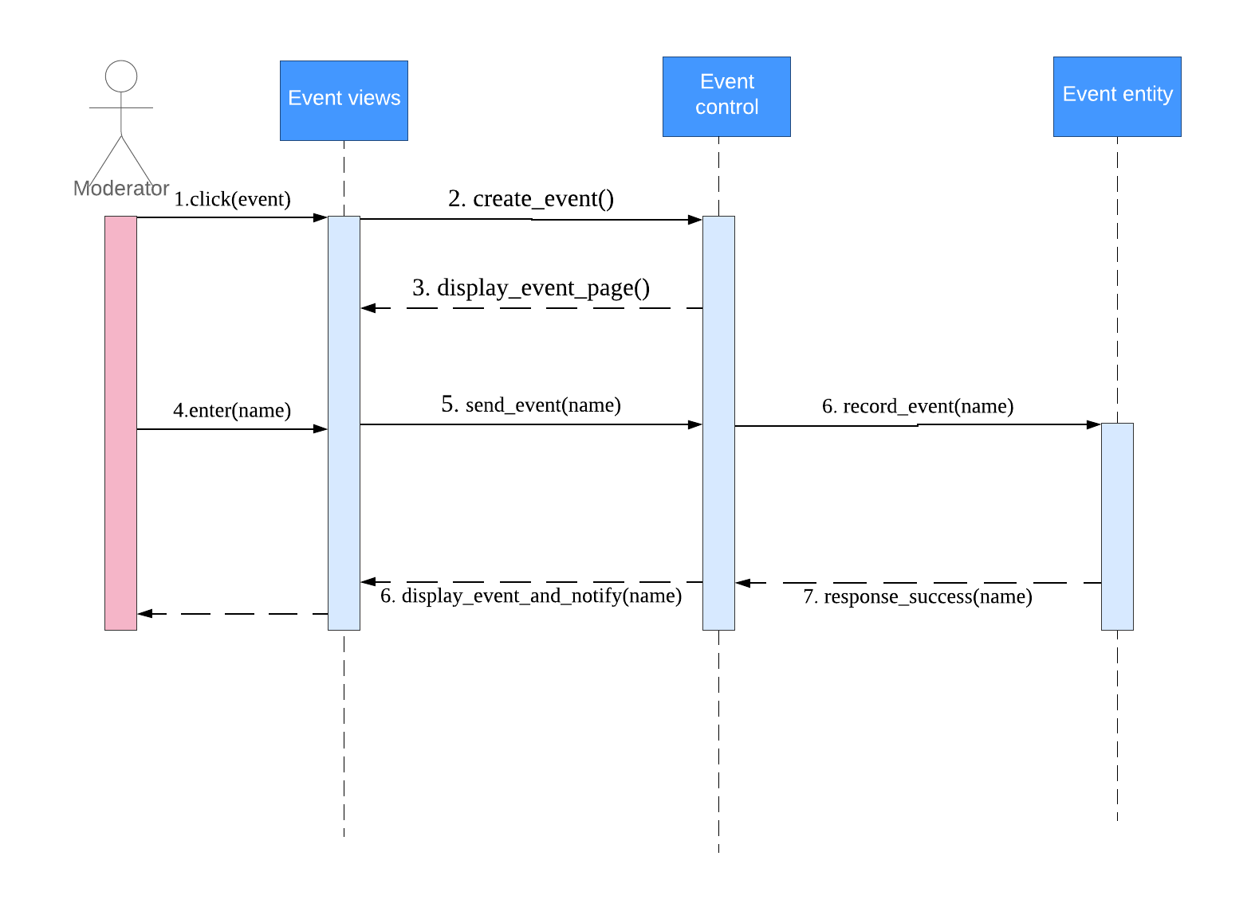
10 Create an event
Notes:
moderator

Slide 69
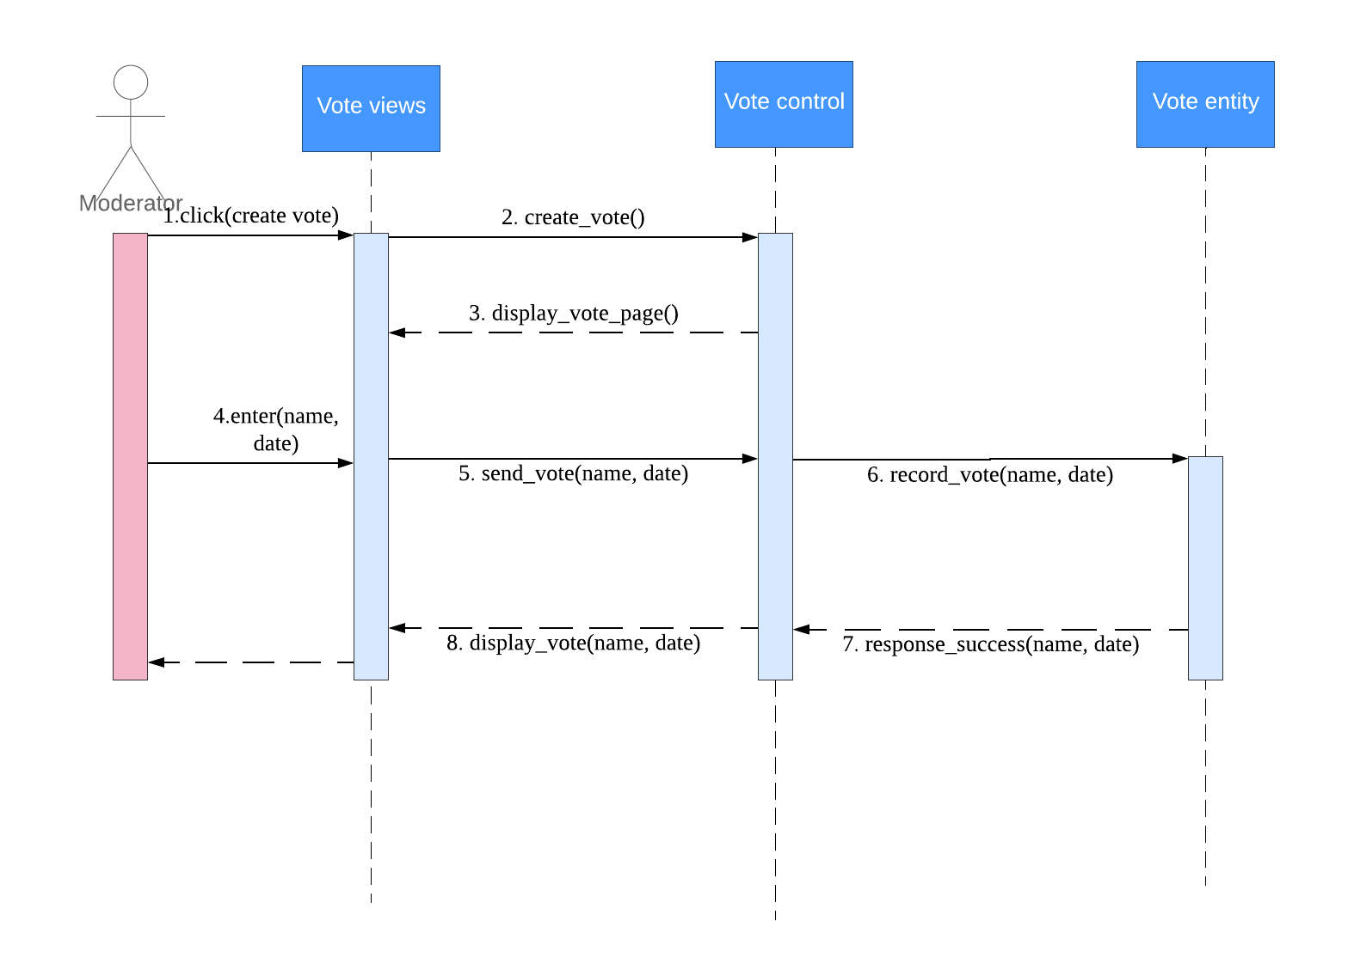
11 Create a vote

Slide 70
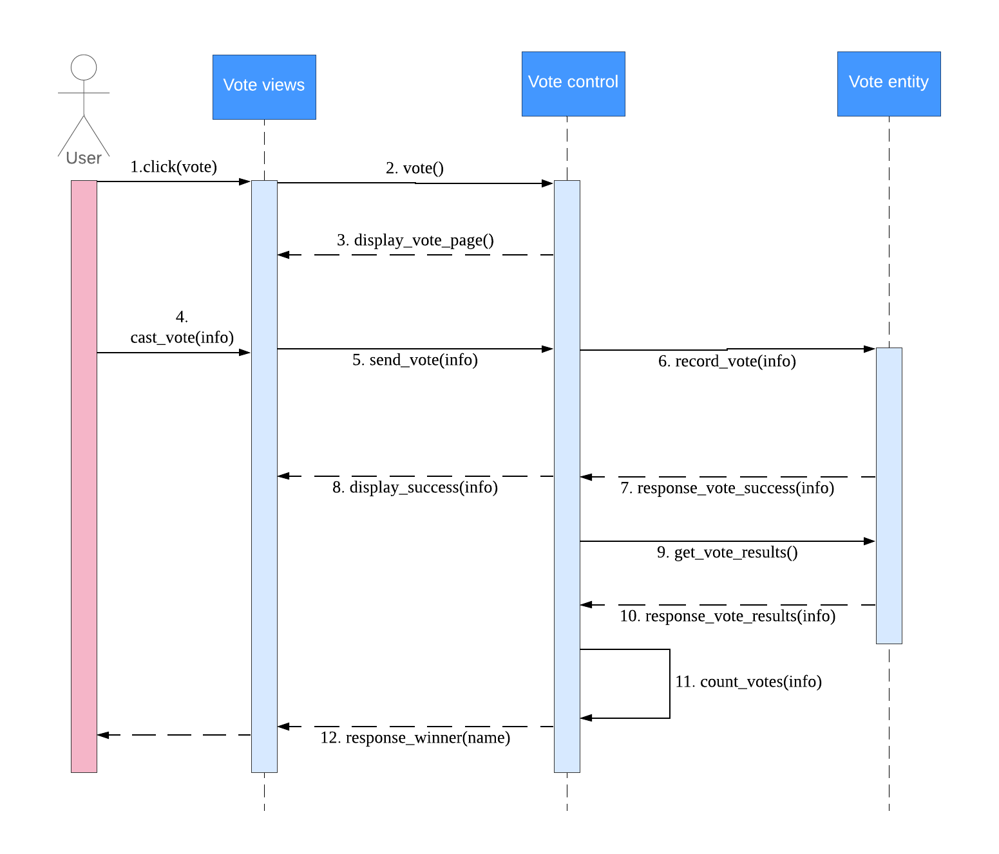
12 Cast a vote

Slide 71
Bi-direction Traceability Matrix

Slide 72
Bi-direction Traceability Matrix
Requirements Source | Requirement | Design Element | Code Function(ID Name) | TestCase
Rule # 1: User can create a group and invite a family and friends to a group. | Group Moderator Module | Use cases/ Group Moderator | 01 Create_a_group() 02 Invite_a_family_and_friends_to_a_group() 05 Populate_movies() 06 Pull_a_movie_list_and_links() 10 Create_an_event() 04 Unsubscribe_groups() 12 Cast_a_vote() | User should be able to create a group User can invite others to the group
Rule # 2: Group members can join a group, browser and search movie lists, watch trailer, browse review, unsubscribe groups, and cast a vote. | Group Members Module | Use cases/ Group Members | 03 Join_a_group() 07 Browser_and_search_movie_list() 08 Watch_trailer() 09 Browse_review() 04 Unsubscribe_groups() 12 Cast_a_vote() | Group members can join group. Group members can browser and search movie lists. Group members can watch trailers Group members can browse reviews group members can unsubscribe groups. Allow group members cast a vote.
Rule # 3: User can choose movies to watch. | Movie Module | Use cases/ Movie | 06 Pull_movie() | User can choose movie to watch
Rule # 4:Moderator create event to decide which movie to watch | Event Module | Use cases/ Event | 10 Create an event() | Moderator can recieve movie decided by user. Moderator can start and end movie.
Rule # 5: Group members sharing their opinions about specific movie | Vote Module | Use cases/ Vote | 11 Create a vote() 12 Cast a vote() | Group members can votes for movie.

Slide 73
Project Implement

Slide 74
Project Implement
Programming Language: Python
IDE: PyCharm
Framework: Django-2.0
Database:MySql
UI Design: Css, Js

Slide 75
Project Implement: Build Apps
according to class diagram, we start 3 new apps in our project:
user, movie, group
user: mainly implemented user register, user login/logout, user information
movie: mainly display the movie list on the front page
group: mainly implemented the group manages functions: display group list, join a group, unsubscribe a group, create an event, create a vote via an event. record a vote

Slide 76
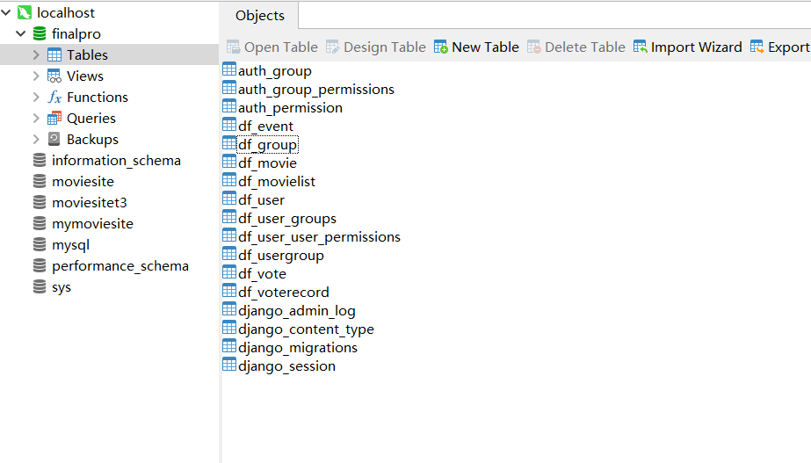
Project Implement: Build Tables

Slide 77
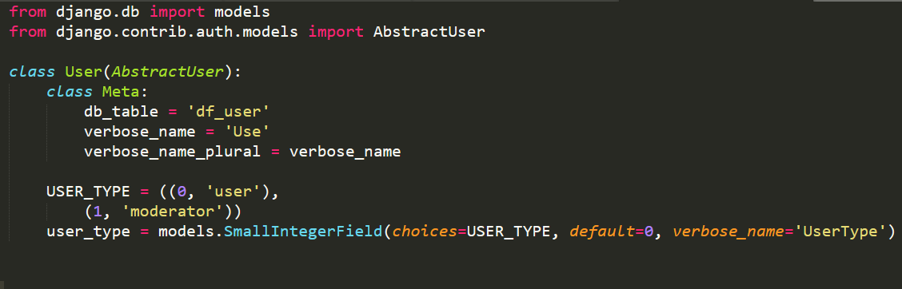
Project Implement: Build tables
How to distinguish two different users’ type: user and moderator:
Use the inherited method to inherit the user class that has been defined in Django, and use a user_type attribute to distinguish the two user types.

Slide 78
Project Implement: Build tables
group models: Group, MovieList, Event, Vote, VoteRecord, UserGroup
Group: to store the basic information about a group
attributes: group_name, group_user(to show the moderator)
MovieList: to display the movie list that a moderator populated in a group
attributes: movie_name, movie_group(ForeignKey)
Event: to store the basic information about an event
attributes: event_name, event_group(ForeignKey), event_movie(ForeignKey)

Slide 79
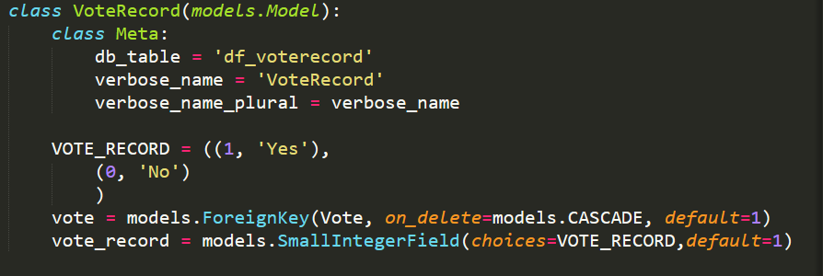
Project Implement: Build tables
group models: Group, MovieList, Event, Vote, VoteRecord, UserGroup
Vote: to store the basic information about a vote
attributes: vote_movie(ForeignKey), open_time, close_time, vote_event(ForeignKey)
Vote Record: to record a vote for each voter
attribute: vote(ForeignKey), vote_record (yes represents going to watch the movie, no represents not )

Slide 80
Project Implement: Build tables
group models: Group, MovieList, Event, Vote, VoteRecord, UserGroup
UserGroup: to store the relationship between a user and a group
attributes: user(ForeignKey), movie(ForeignKey)

Slide 81
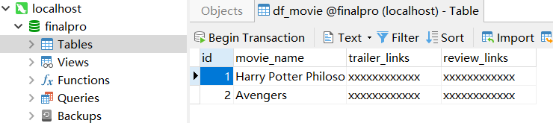
Project Implement: Build tables
movie model: movie
movie: to store the basic movie information that the website already populated
attributes: movie_name, trailer_links(provided by third party webs), review_links(provided by third party webs)

Slide 82
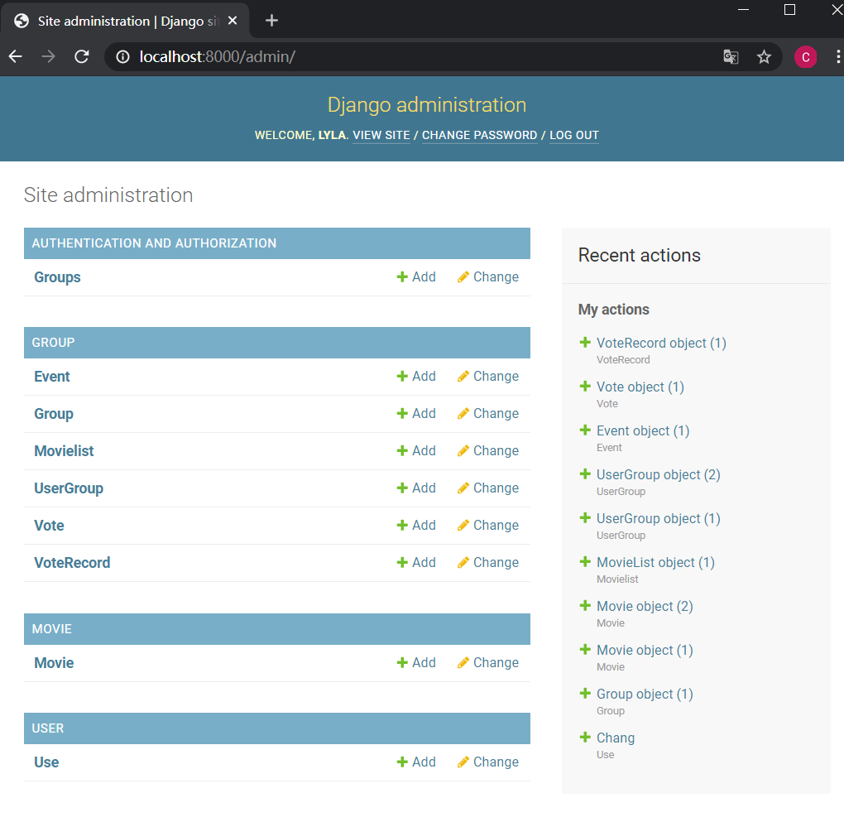
Setting Admin:

Slide 83
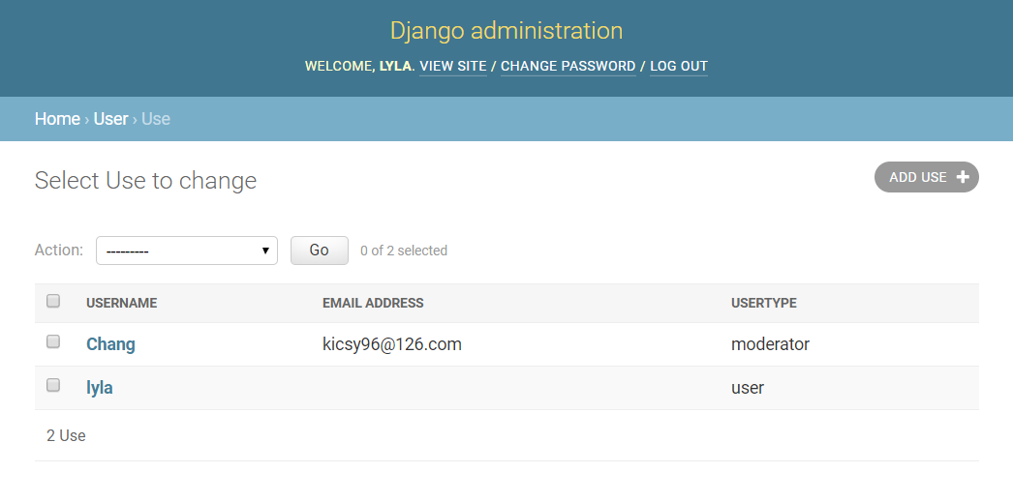
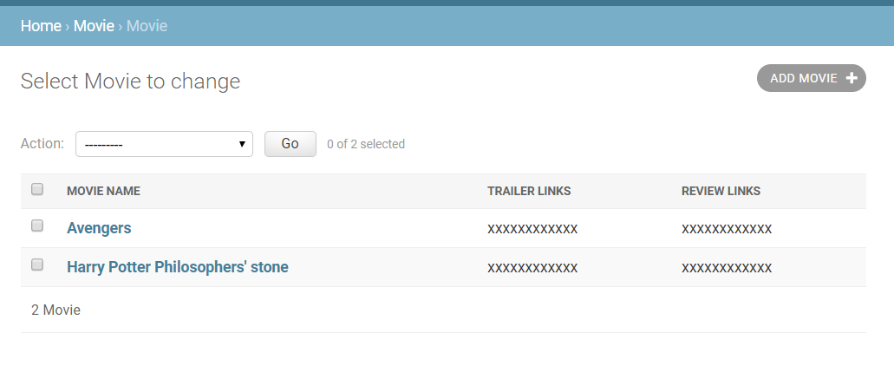
Admin display:

Slide 84
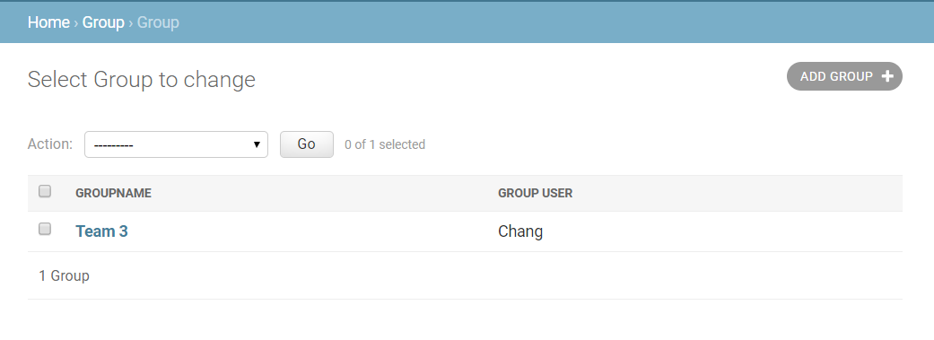
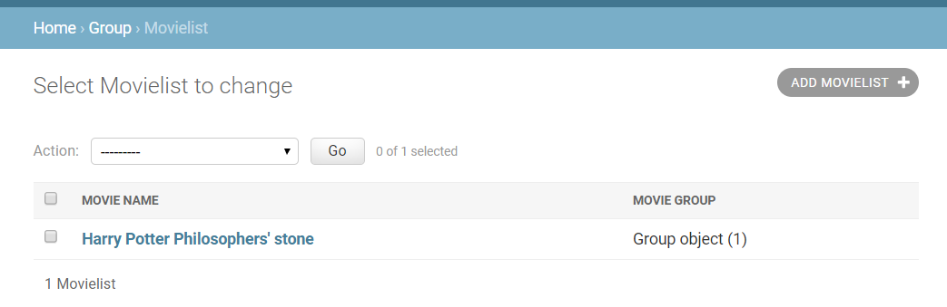
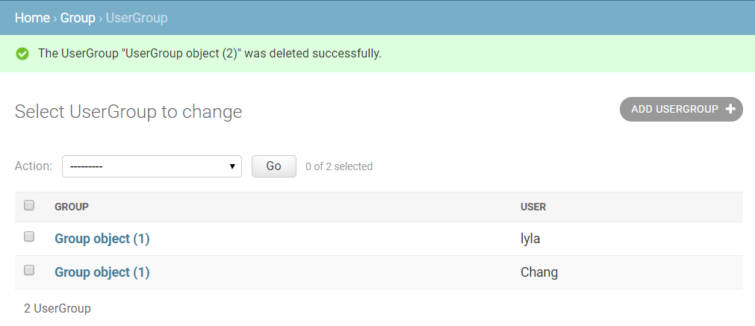
Admin display:

Slide 85
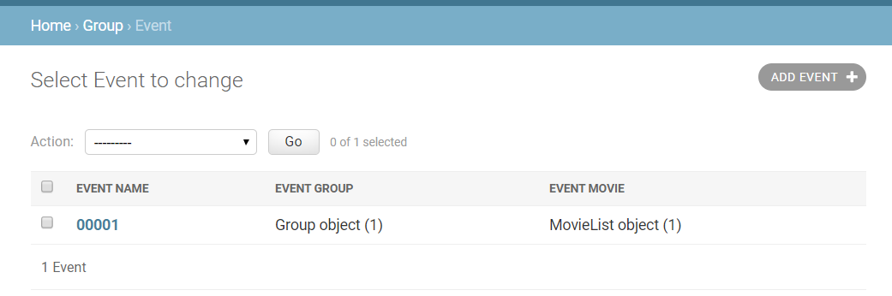
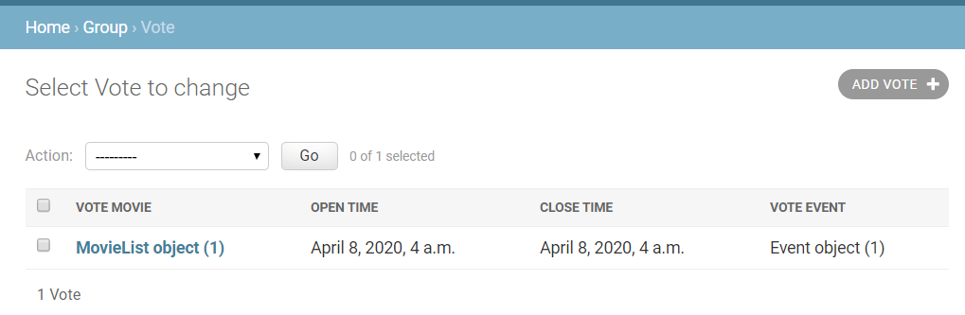
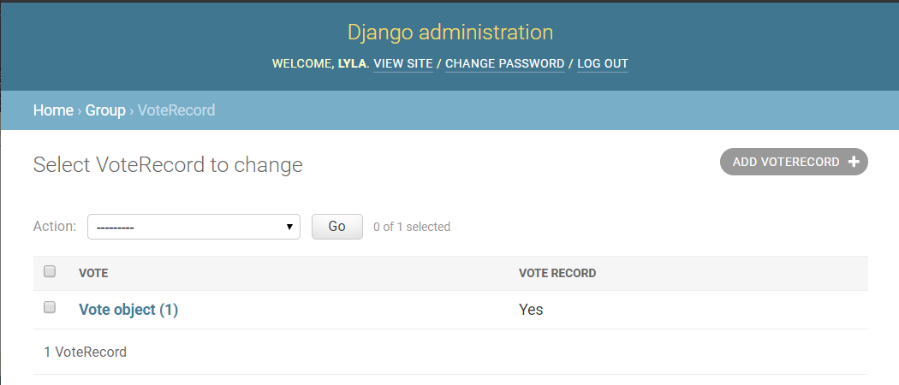
Admin display:

Slide 86
Functions:
According to our demand analysis, we implement such functions:
user: Register, Login, Logout, User information center
view: Register, Login, Logout, UserInfo
movie:
view: List(show the movie name of the movie list)

Slide 87
Functions:
group: create a group, join a group, unsubscribe a group, create an event, create a vote
view: Index(display group list), GroupCreate, GroupJoin, GroupUnsubscribe, EventCreate, EventView, VoteCreate, VoteView, VoteRecordView

Slide 88
Coding example:
Request method, using ajax post:
If it involves data modification (addition, update, deletion), use post
If only involves data acquisition, use get
Store the data received from the front-end into the database
Return message: JsonResponse

Slide 89
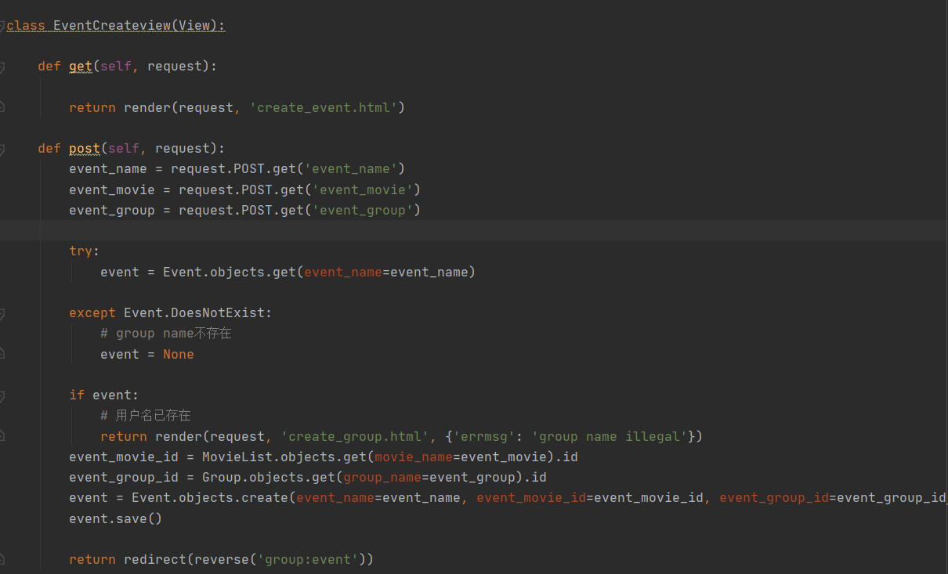
Coding
example:
user could create
an event for a
existing group

Slide 90
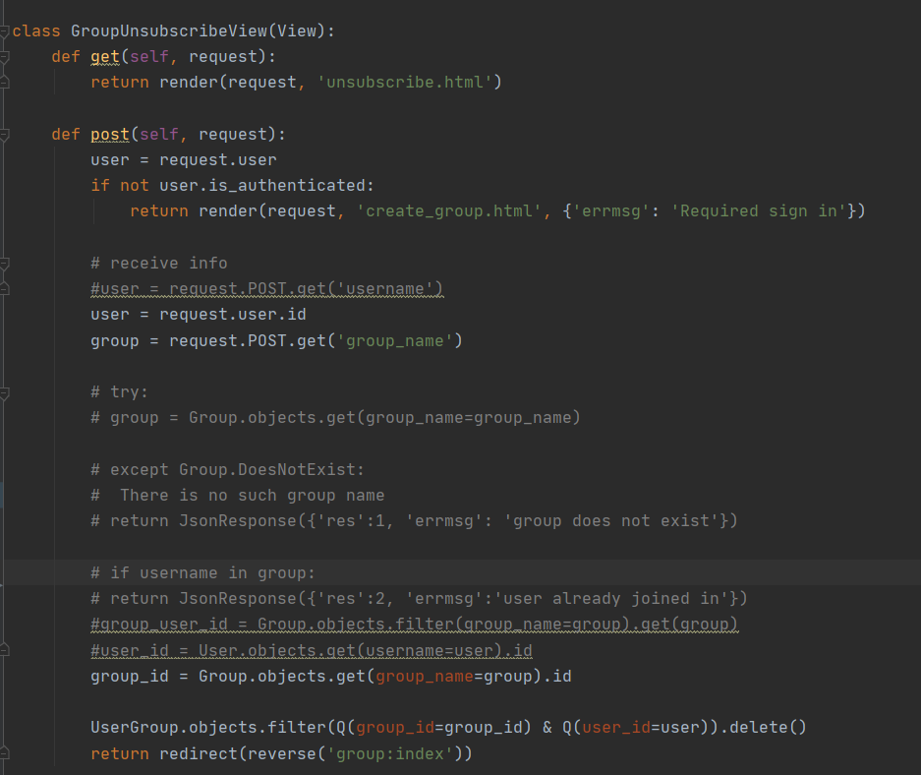
Coding
Example:
user could unsubscribe
from a group which he/she
already joined in

Slide 91
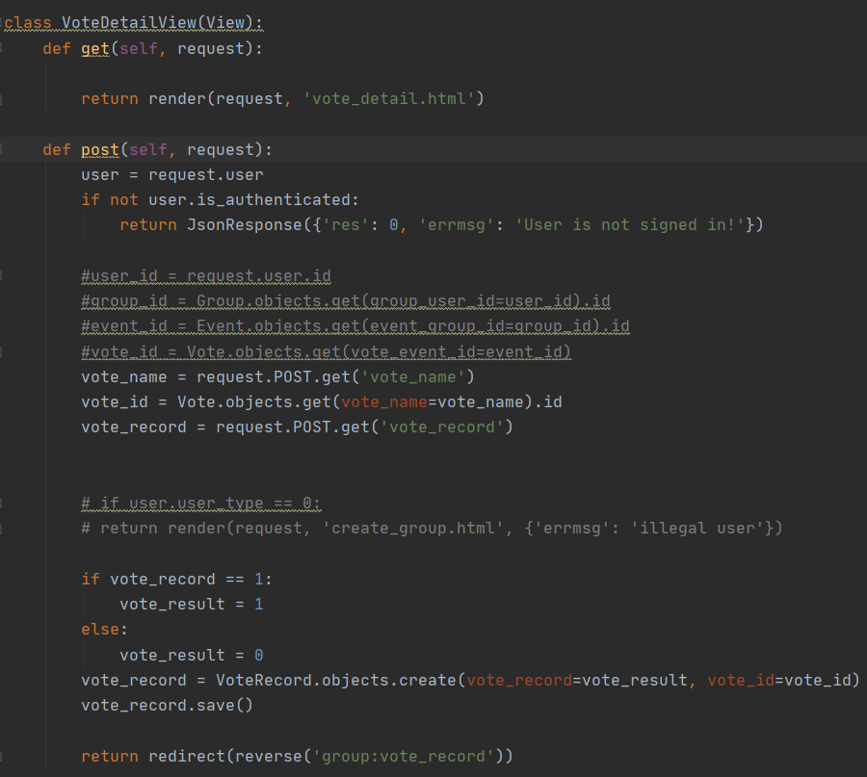
Coding
Example:
User who joined in a vote
could user this page to make
a yes or no choice

Slide 92
User Interface Design
(Mock-up Prototype)

Slide 93
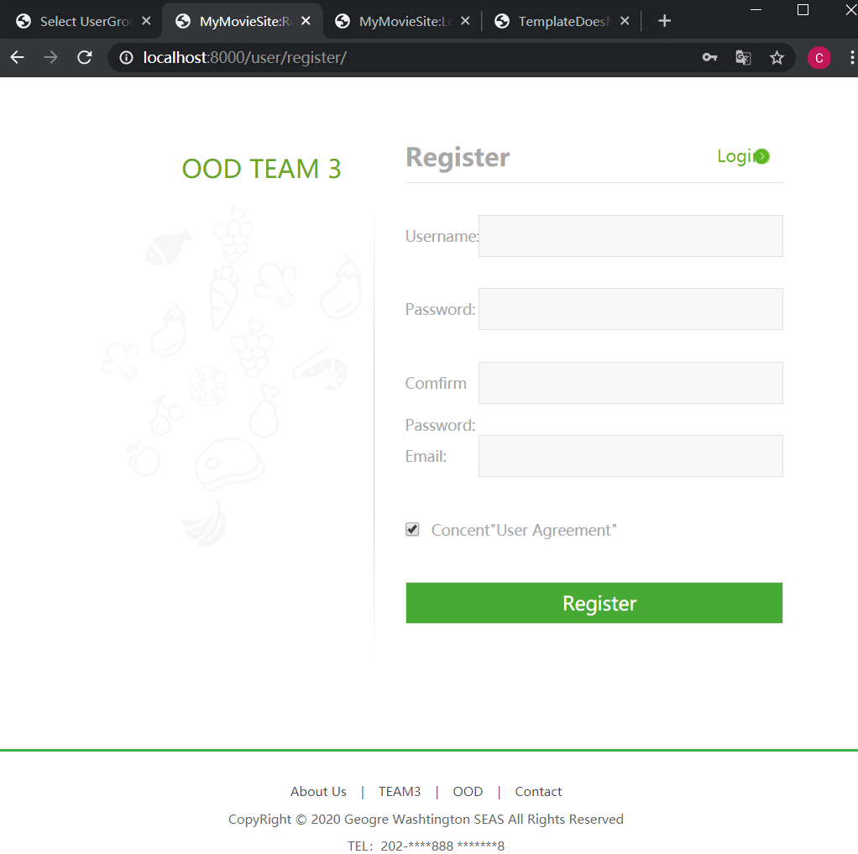
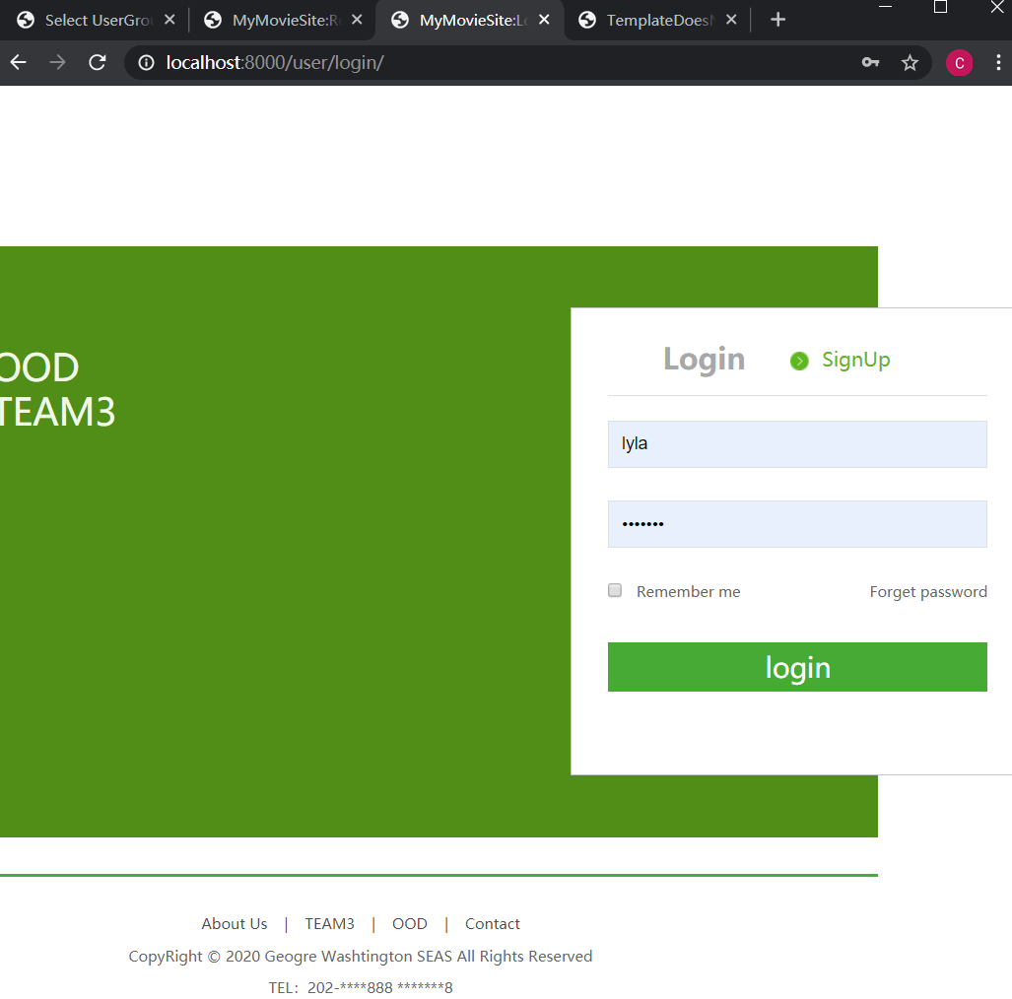
Register/login

Slide 94
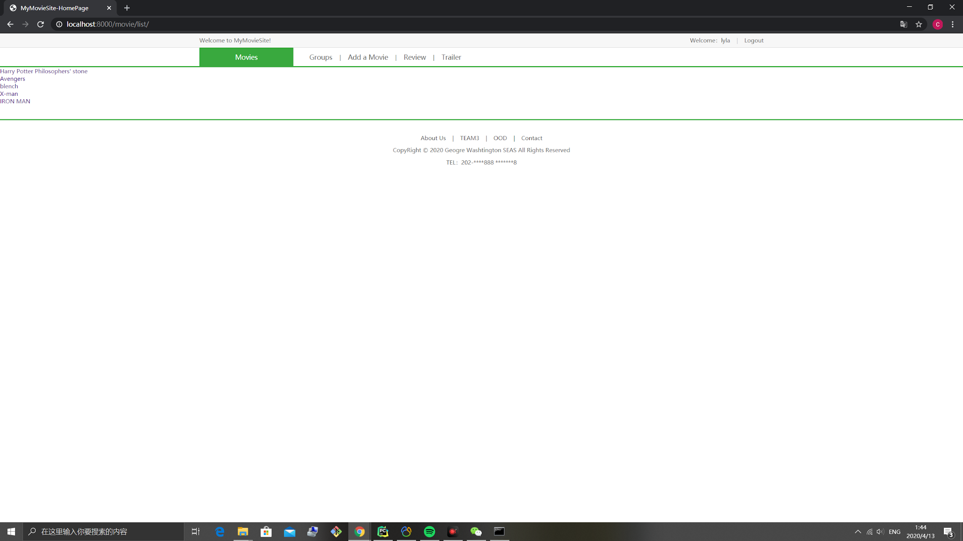
Home：
show the movie
list

Slide 95
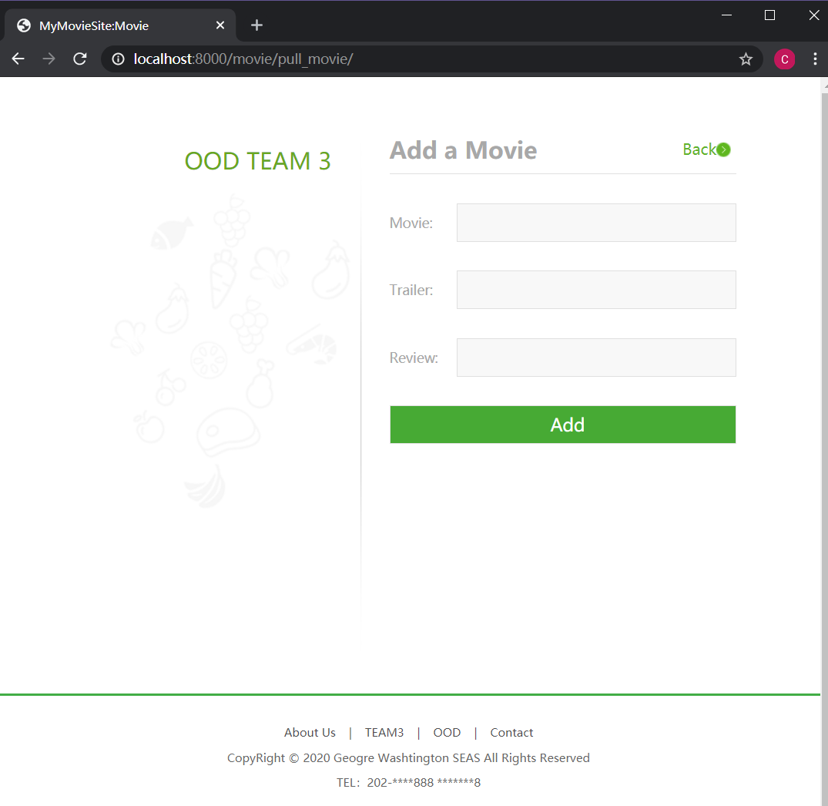
User could add a movie
through this page

Slide 96
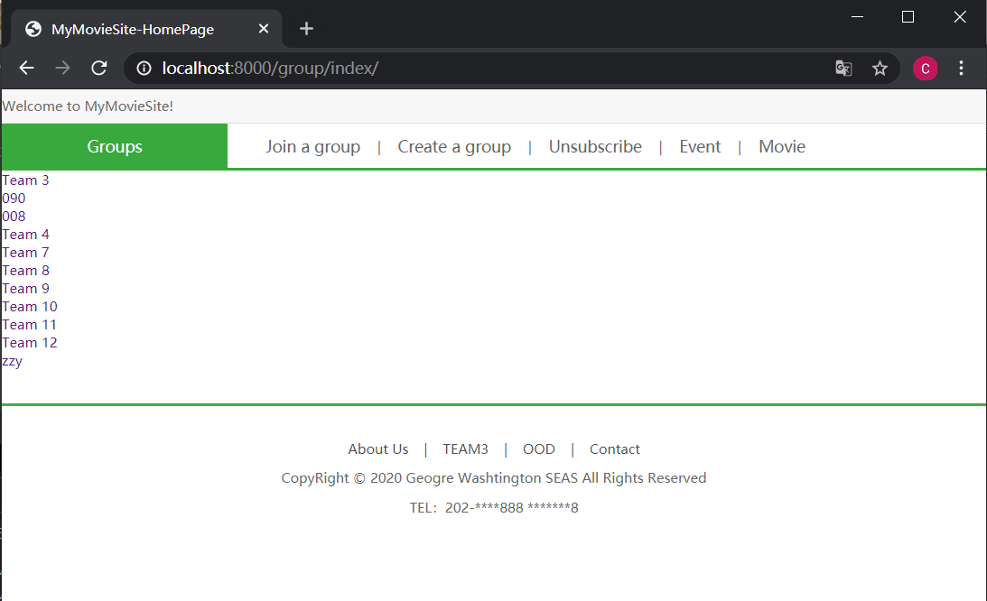
group/index: show the group list
Functions: Join a group, create a group, unsubscribe

Slide 97
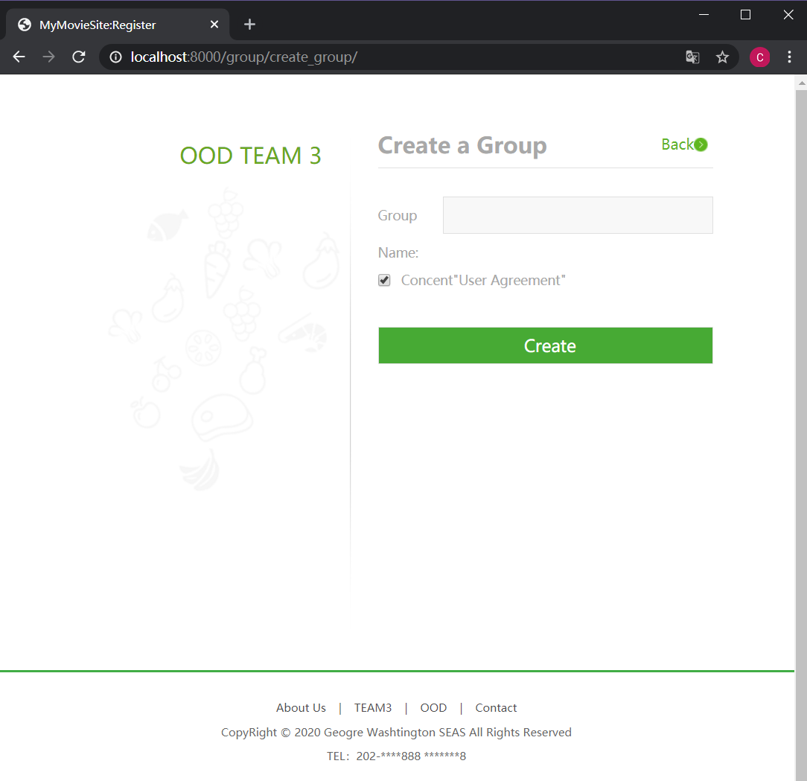
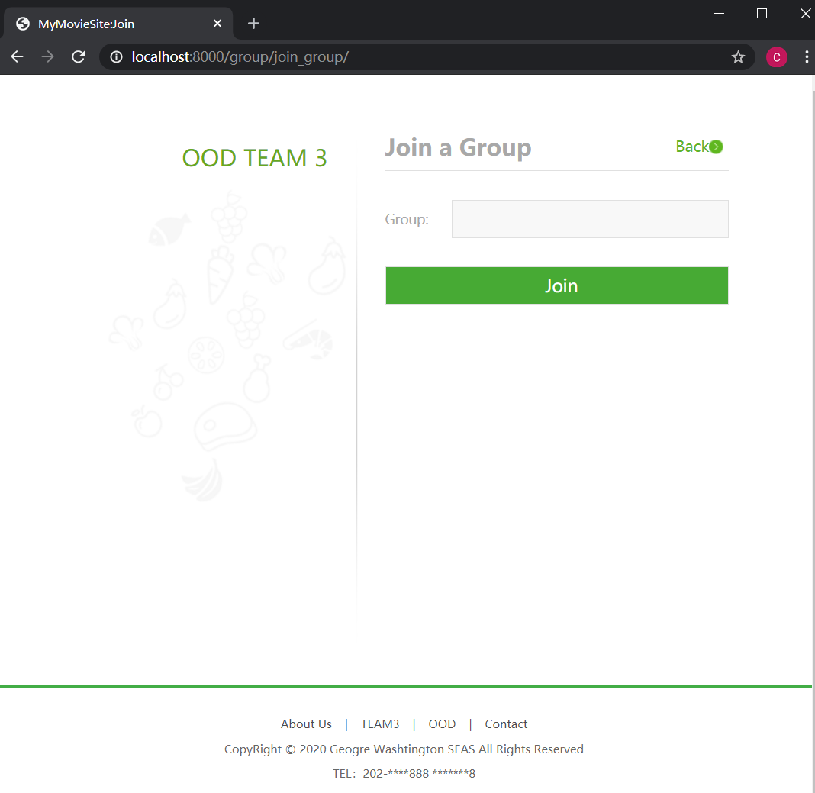
create a group, join a group

Slide 98
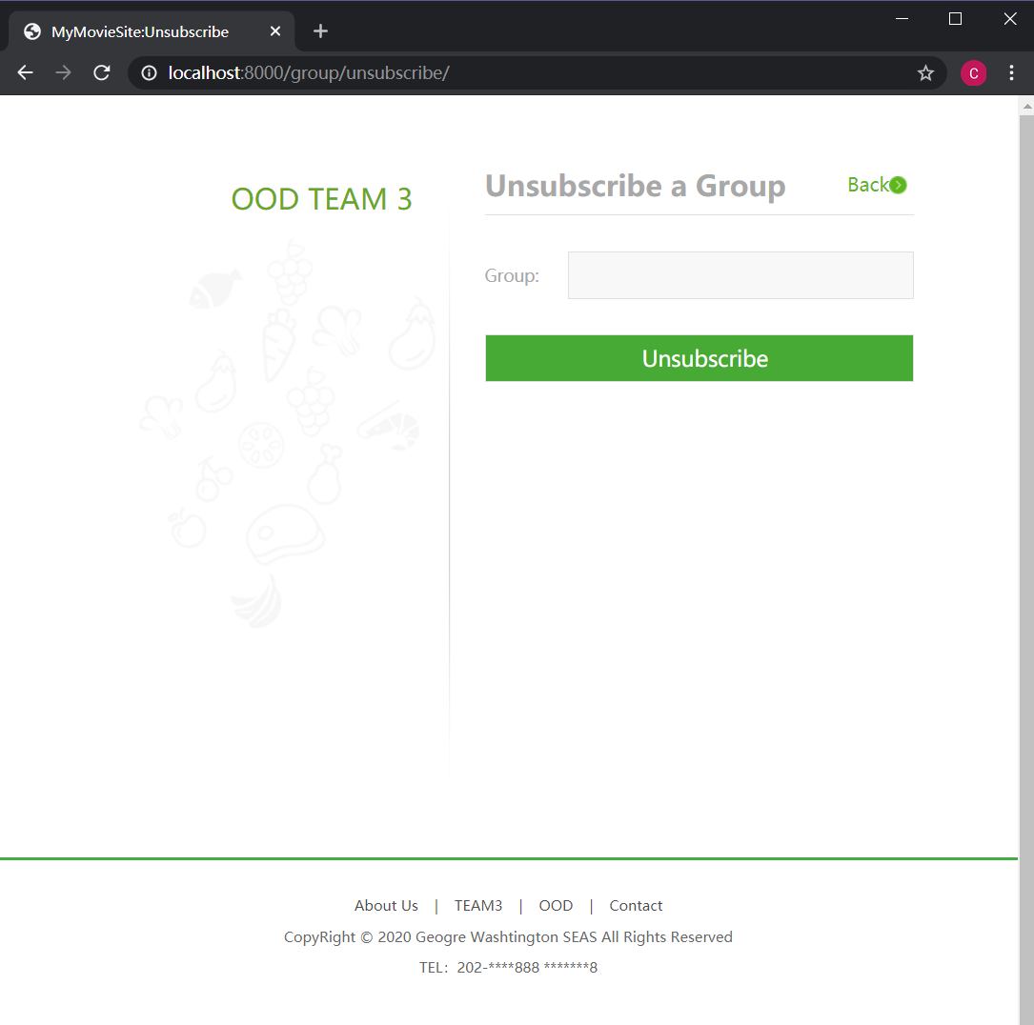
unsubscribe a group from a group list for a signed in user

Slide 99
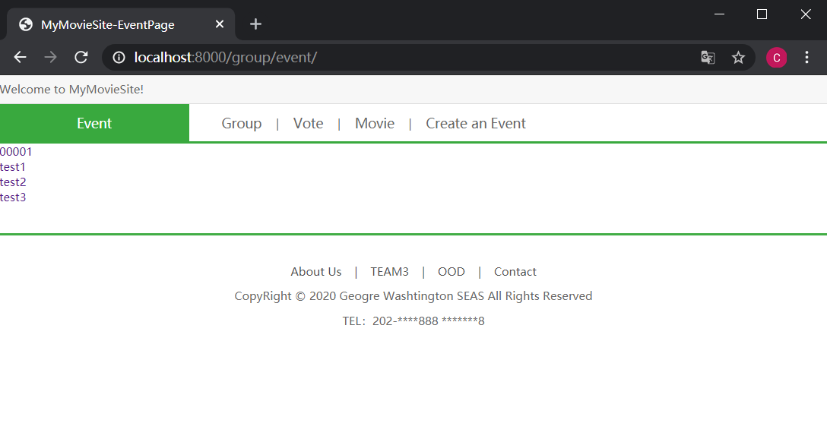
event: show the event list

Slide 100
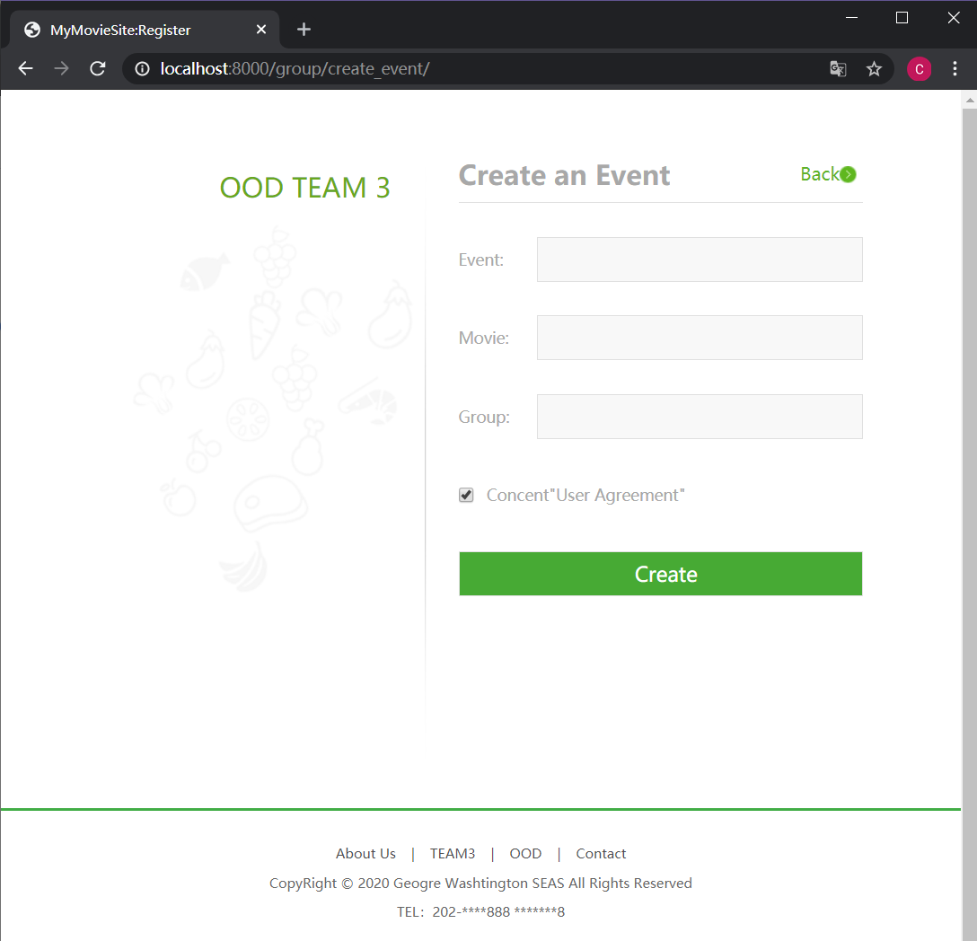
create an event

Slide 101
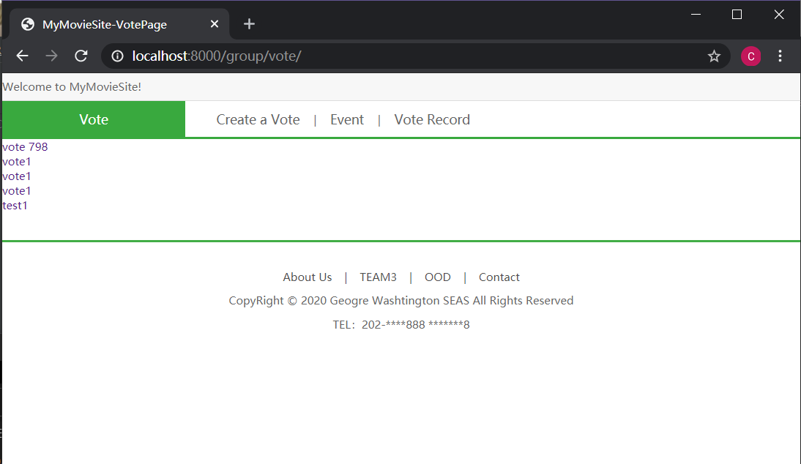
vote: show the vote list

Slide 102
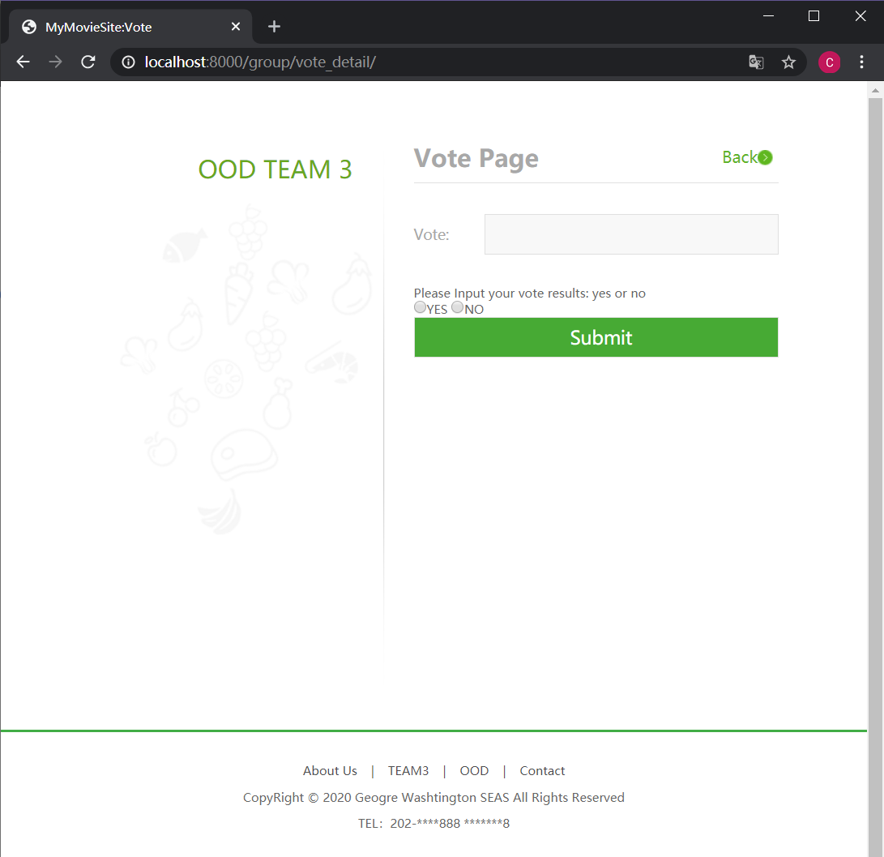
user through click the vote name to enter the vote page

Slide 103
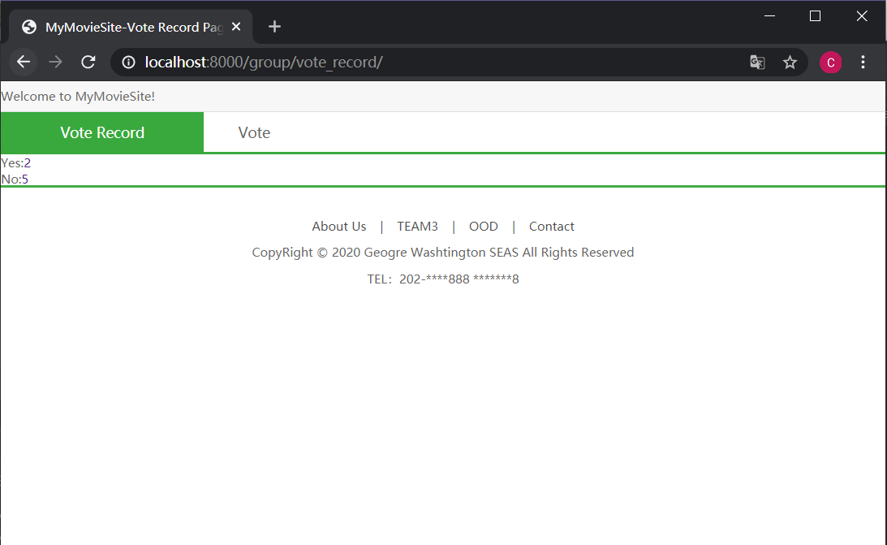
vote record show the results of a vote

Slide 104
Operational Prototype

Slide 105
GitHub demo video link: https://github.com/Nora-Wang/CSCI_6234_10_Group3/blob/master/Demo%20video.mp4

Slide 106
Thanks
Che Li,
Chang Li,
Yuting Wang,
Yakun Zhang

